Slide 1
Lecture 4: Normalization

Slide 2
Introduction
ERD is mapped to a relational schema (i.e., a table structure).
Normalization is a systematic process to evaluate and design good table structure to control data redundancy, hence avoiding data anomalies.

Slide 3
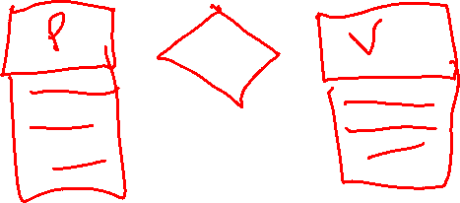
Example 1: Products/Vendors Database
Each type of product has a description and a identifying code.
Each product is supplied by zero or more vendors.
Each vendor might offer the product at a different price.
Each vendor has an identifying code, name, and contact information.

Slide 4
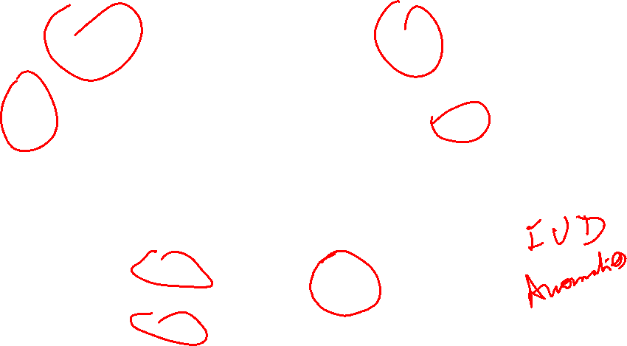
ERD for Example 1
Price
P_Descr
V_Contact
P_CODE
Supplied_Products
V_CODE
P_Code | P_Descr | V_Code | V_Contact | Price
P1 | Hammer | V1 | Smith | 10.5
P2 | Screw | V1 | Smith | 11.5
P3 | Hammer | V2 | Emily | 13.5

Slide 5
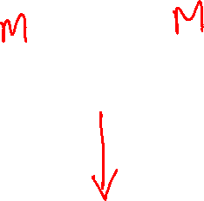
Alternative ERD for Example 1
Price
V_Contact
V_CODE
P_CODE
P_Descr
Product
Supplies
Vendor
P_Code | P_Descript
P1 | Hammer
P2 | Screw
P3 | Chain
V_Code | V_Contact
V1 | Smith
V2 | Emily
V3 | John
V_Code | P_Code | Price
V1 | P1 | 10.5
V1 | P2 | 11.5
V2 | P1 | 13.5
Is one schema better than the other? Why?
What does it mean for a schema to be good?

Slide 6
Relational database design
Major aim of relational database design is to group columns into tables to minimize data redundancy and reduce file storage space required by base tables.
The single table schema suffers from the following:
Redundancy, and as a result:
Increased storage space
Anomalies (examples?)
Insertion anomaly
Occurs when extra data beyond the desired data must be added to the database.
Update anomaly
Occurs when it is necessary to change multiple rows to modify ONLY a single fact.
Deletion anomaly
Occurs whenever deleting a row inadvertently causes other data to be deleted

Slide 7
Is more tables always better?
P_Code
P1
P2
P3
P_Descr
Hammer
Screw
Chain
V_Code
V1
V2
V3
V_Contact
Smith
Emily
John
Price
10.5
11.5
13.5
Information about relationships is lost!

Slide 8
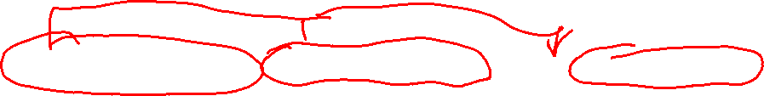
Example 2
StdSSN | StdCity | StdClass | OfferNo | OffTerm | OffYear | EnrGrade | CourseNo | CrsDesc
S1 | SEATTLE | JUN | O1 | FALL | 2006 | 3.5 | C1 | DB
S1 | SEATTLE | JUN | O2 | FALL | 2006 | 3.3 | C2 | VB
S2 | BOTHELL | JUN | O3 | SPRING | 2007 | 3.1 | C3 | OO
S2 | BOTHELL | JUN | O2 | FALL | 2006 | 3.4 | C2 | VB

Slide 9
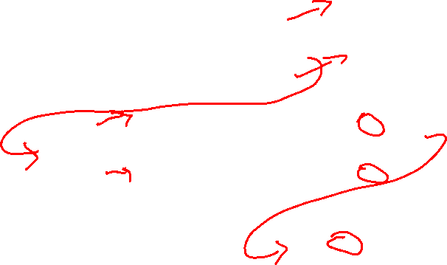
Example 2 Contd.
StdSSN | StdCity | StdClass | EnrGrade | OfferNo
S1 | SEATTLE | JUN | 3.5 | O1
S1 | SEATTLE | JUN | 3.3 | O2
S2 | BOTHELL | JUN | 3.1 | O3
S2 | BOTHELL | JUN | 3.4 | O2
OfferNo | OffTerm | OffYear | CourseNo
O1 | FALL | 2006 | C1
O2 | FALL | 2006 | C2
O3 | SPRING | 2007 | C3
O2 | FALL | 2006 | C2
CourseNo | CrsDesc
C1 | DB
C2 | VB
C3 | OO
C2 | VB

Slide 10

Example 3
StaffBranch Table

Slide 11

Staff and Branch Tables

Slide 12
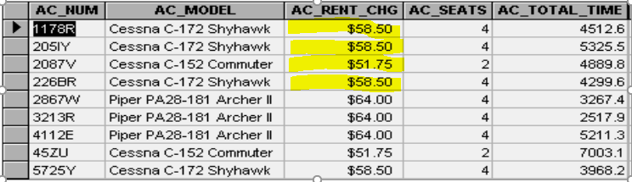
Example 4 AIRCRAFT Table

Slide 13
Example 4
Model
Aircraft

Slide 14
Designing Good Databases
A methodology for evaluating good schemas:
Detecting anomalies
How do we know an anomaly exists?
functional dependency helps in detecting anomalies
A methodology for transforming bad schemas into good schemas:
Preventing anomalies
How do we resolve anomalies?
Normalizations (or schema decomposition) can prevent anomalies while retaining all information

Slide 15
Normalization
Normalization is a systematic process to evaluate and design good table structure to control data redundancy, hence avoiding data anomalies.
Degrees of Normalization
1st Normal Form
2nD Normal Form
3rd Normal Form
Boyce-Codd NF
4th NF
……. And so on
In practice, 3NF is sufficient for 99% of relational databases

Slide 16

Atomicity of Attributes
Domain is atomic if its elements are considered to be indivisible units
Examples of atomic domains:
Unique identifiers, like SSN
Identification numbers which are sequentially numeric
Non-atomic values complicate storage and encourage redundant (repeated) storage of data
Example:
Set of accounts stored with each customer, and set of owners stored with each account
Set of employees with each project

Slide 17

Normalization
First normal form (1NF) :
A relation is in first normal form if and only if the domain of each attribute contains only atomic (indivisible) values, and the value of each attribute contains only a single value from that domain
A table in which the intersection of every column and record contains only one value. It prohibits nesting or repeating groups in table. The intersection must be atomic.
All attributes are dependent on the primary key

Slide 18
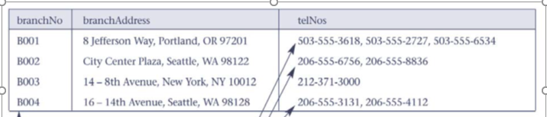
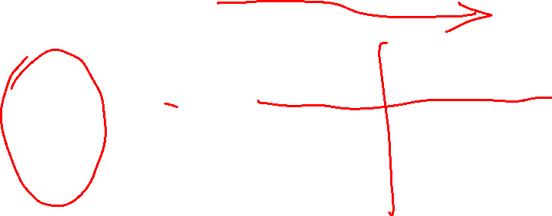
Example 1NF
Is this in 1NF?
Why or Why not?

Slide 19
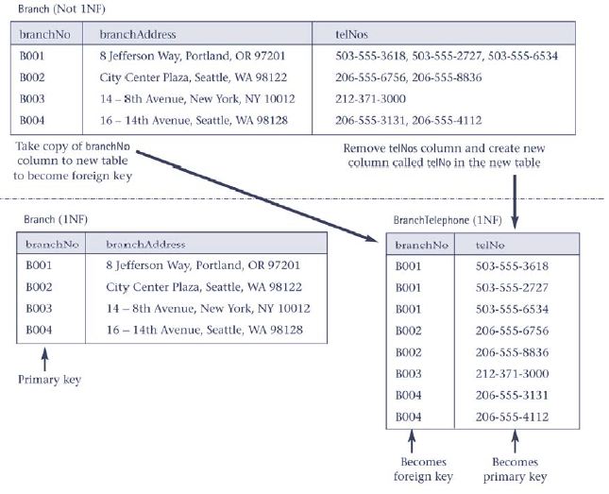
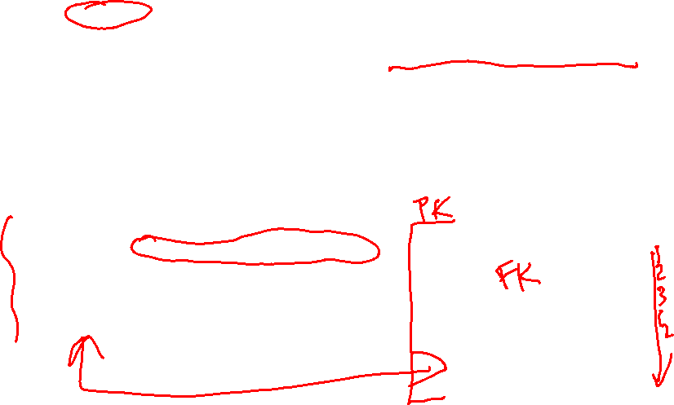
How do we get to 1NF?

Slide 20
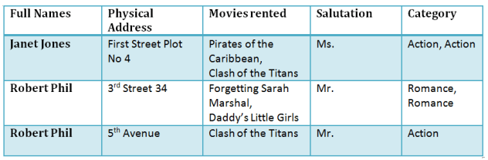
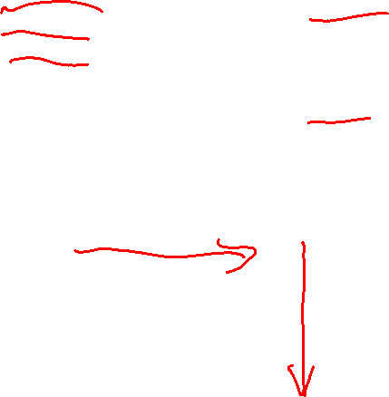
Example 1 NF
1NF (First Normal Form) Rules
Each table cell should contain a single value.
Each record needs to be unique.

Slide 21
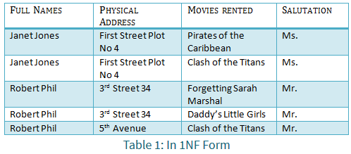
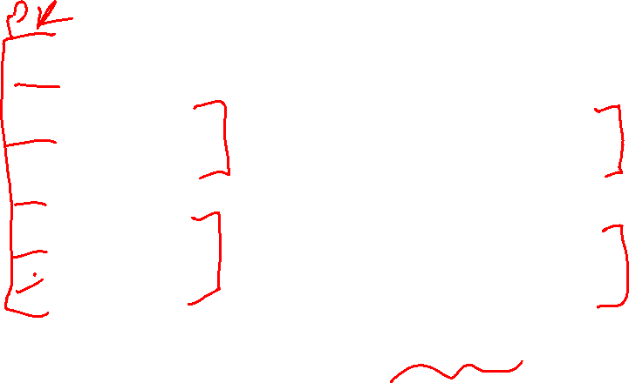
Example 1 NF

Slide 22
Normalizing a table into 2 NF
Second normal form (2NF) is the second step in normalizing a database. 2NF builds on the first normal form (1NF).
Normalization is the process of organizing data in a database so that it meets two basic requirements:
There is no redundancy of data (all data is stored in only one place).
Data dependencies are logical (all related data items are stored together).
A relation is in 2NF if it is in 1NF and every non-prime attribute of the relation is dependent on the whole of every candidate key.
2NF frequently applies to tables with composite primary keys (more than one primary key), in order to avoid partial dependency. In such cases, all non-key attributes must be completely dependent on composite keys.
Why do we need to convert a relation to 2NF?

Slide 23
Functional Dependency
Attribute B is fully functionally dependent on attribute A if each value of A determines one and only one value of B:
A Determines B
A➔ B:
Determinant ➔ Dependent
Concept of determination:
Attribute A determines attribute B if all the rows in the table that have the same value of A also have the same value for B

Slide 24
The Functional dependency
Consider a table with columns A and B, where B is functionally dependent on A (denoted A → B). If we know the value of A, we find only one value of B in all the records that has this value of A, at any moment in time.
Functional Dependency (FD) Definition
X → Y.
X (functionally) determines Y or Y is functionally dependent on X.
X: left-hand-side (LHS) or determinant.
For each X value, there is at most one Y value

Slide 25
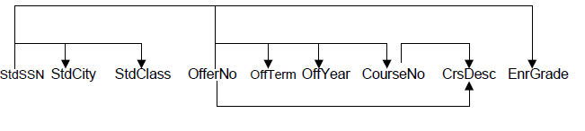
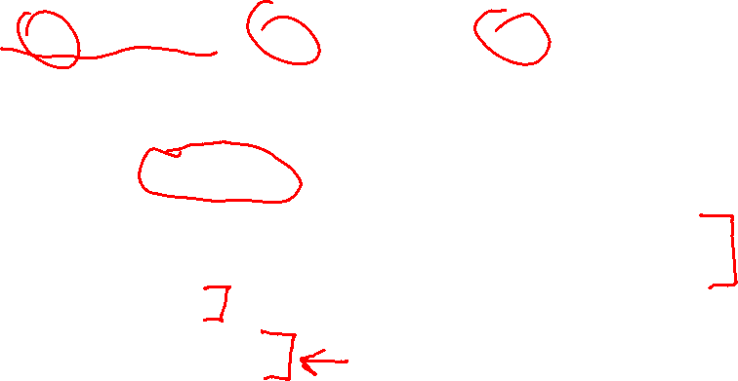
Example of Functional Dependency
Normalization to 2NF
The FDs in this case are:
Primary key is: stdSSN + offerNo
StdSSN ➔ StdCity, StdClass ➔ Partial functional dependency
OfferNo ➔ offTerm, OffYear, Courseno, CrsDesc ➔ partial functional dependency
CourseNo ➔ CrsDesc
StdSSN, OfferNo ➔ EnrGrade

Slide 26
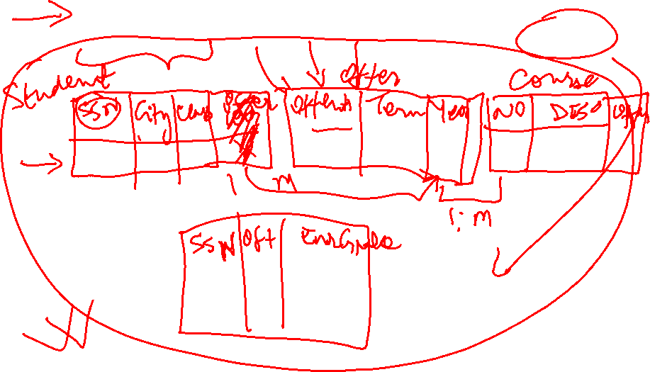
Normalization to 2NF

Slide 27
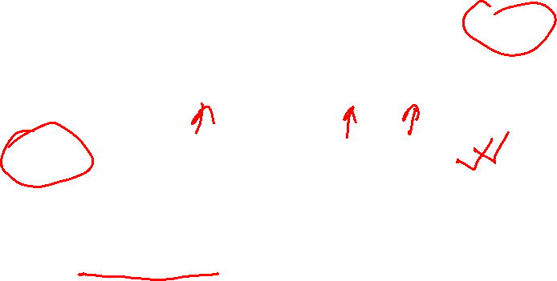
Is this Relation in 2NF?

Slide 28

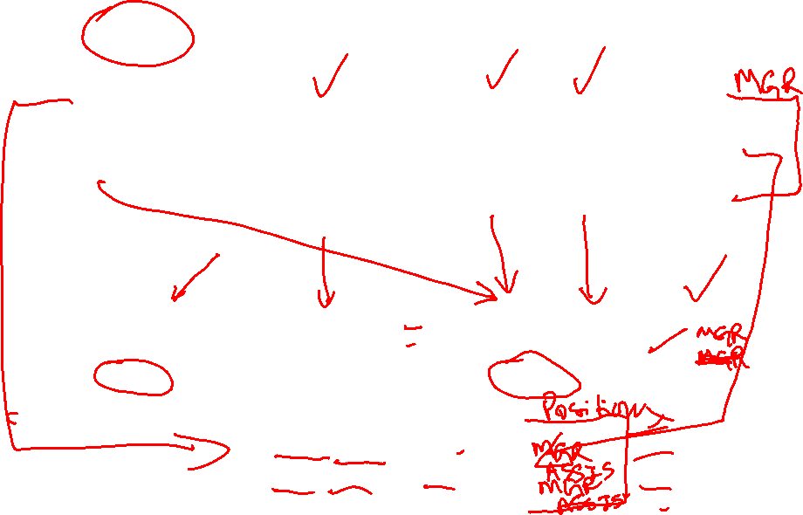
Normalization to 2NF

Slide 29
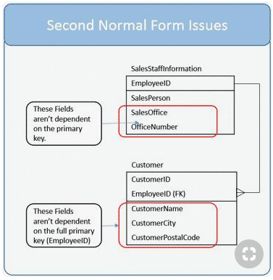
Normalization to 2NF

Slide 30
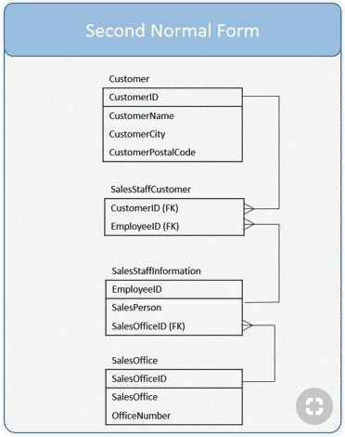
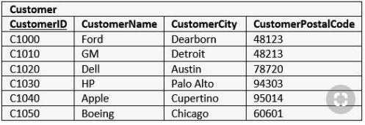
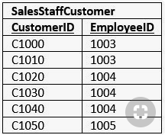
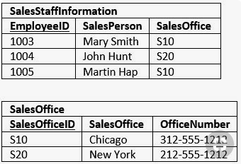
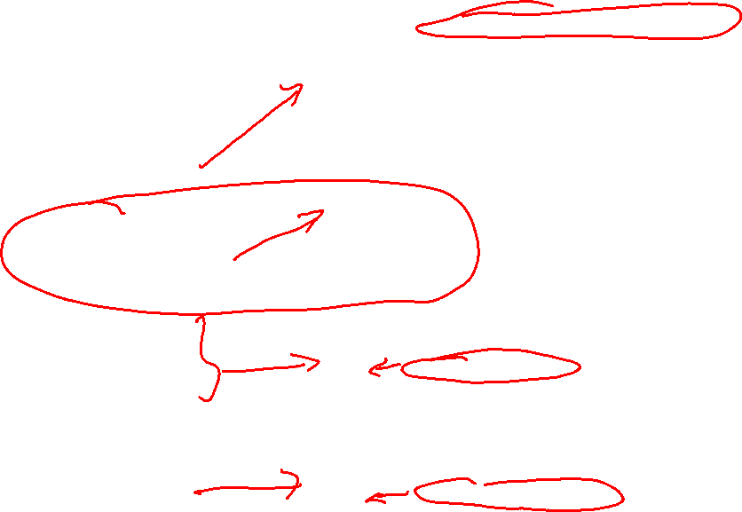
Normalization to 2NF

Slide 31
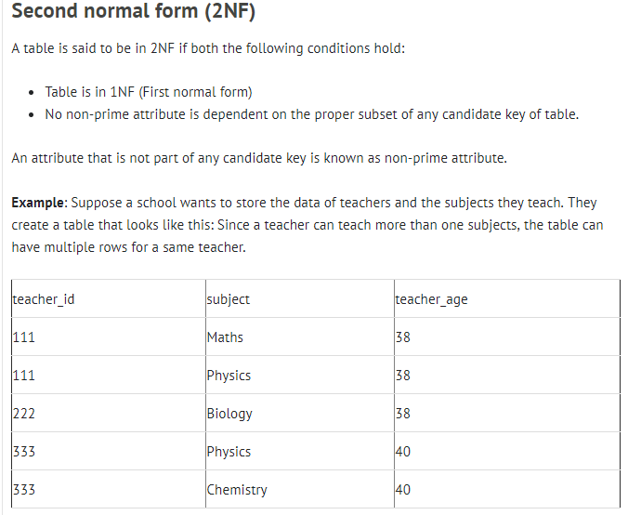
Normalization to 2NF

Slide 32
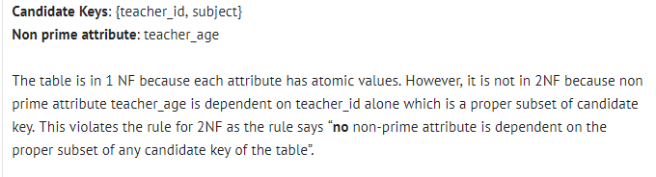
Normalization to 2NF

Slide 33
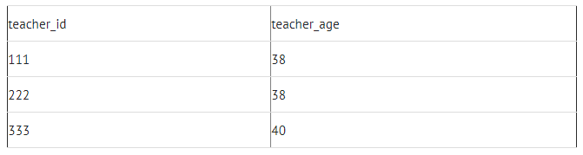
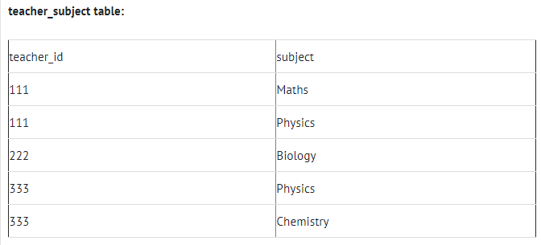
Normalization to 2NF

Slide 34
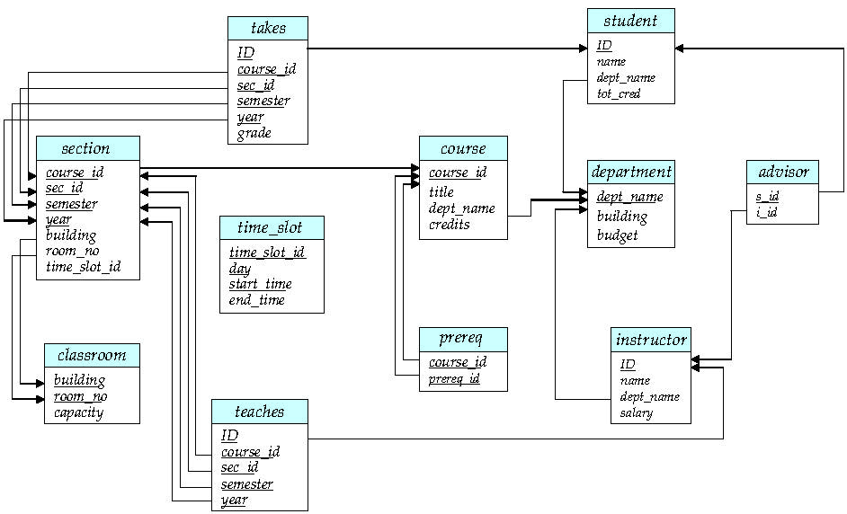

Schema Diagram for University Database
What are the examples of Functional dependency or 2NF in this Schema?

Slide 35

Identifying Functional Dependencies
Some FD can be identified by statements about uniqueness. When converting an ERD to a database schema, check for unique column, which should be on LHS (determinant) and related columns (Dependent) on right
E.g. a user may state that each staff member has a unique name and position
staffNo → name, position
You can also identify functional dependencies in a table design resulting from the conversion of an ERD. FD would be asserted for each unique column (PK or other candidate key) with the unique column as the LHS and other columns in the table on the RHS
When you see a statement about a 1-M relationship, the FD is derived from the child-to-parent direction, not the parent-to-child direction
E.g. Course and Department tables
There are several commercial database design tools that automate the process of eliminating dependencies through examination of sample rows. Ultimately, the database designer must make the final decision about FDs that exist in a table.

Slide 36
Normalizing a table into 3 NF
A table that is in 1NF and 2NF and in which all non-primary-key column can be worked out from only the primary key column(s) and no other columns.
At this level, the combined definition of 2NF and 3NF is that table is in 3NF if each non-key column depends on all candidate keys, whole candidate keys and nothing but candidate keys
For 2NF we should remove partial dependency and for 3NF we should remove transitive dependency.
What is transitive dependency?

Slide 37
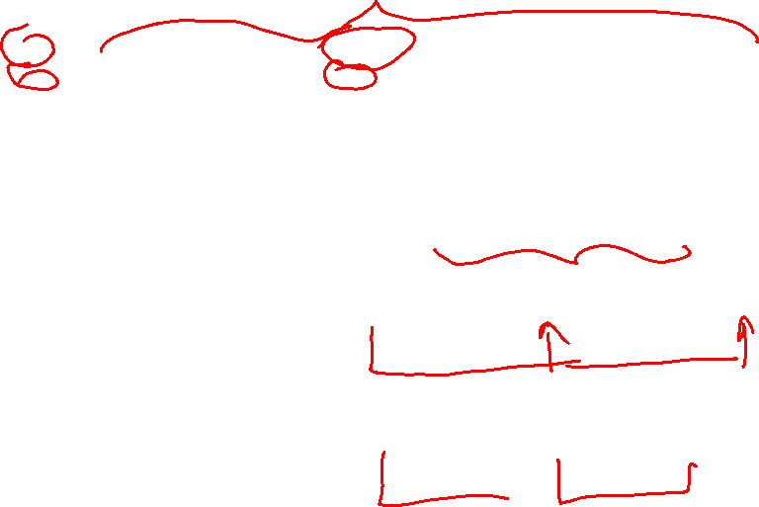
Example - StaffBranch table is not in 3NF

Slide 38
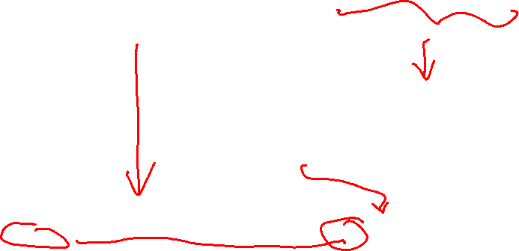
Example 3NF

Slide 39
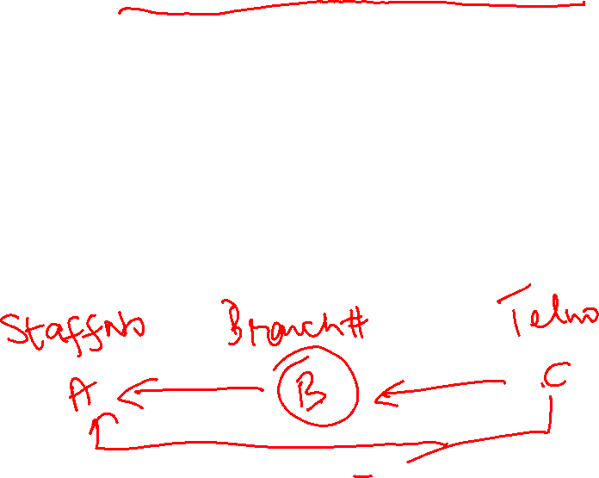
Transitive Dependency
The formal definition of 3NF is a table that is in 1NF and 2NF and in which no non-primary-key column is transitively dependent on the primary key.
For example, consider a table with A, B, and C. If B is functional dependent on A (A → B) and C is functional dependent on B (B → C), then C is transitively dependent on A via B (provided that A is not functionally dependent on B or C).
If a transitive dependency exists on the primary key, the table is not in 3NF

Slide 40
Third Normal Form
Eliminating transitive dependency
Each transitive dependency is mapped to a table
Steps:
Determinant attribute is the PK for the new table
The dependent attributes are moved to the new table
CourseNo➔ CrsDesc
Remove the dependent attribute from the original table
The determinant attribute remains in the original table
EMP_NUM ➔ EMP_NAME, JOB_CLASS

Slide 41
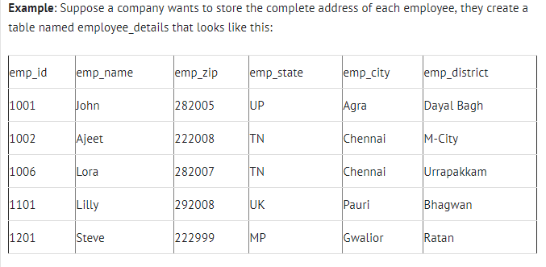
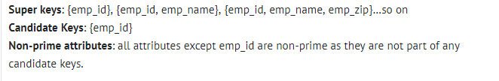
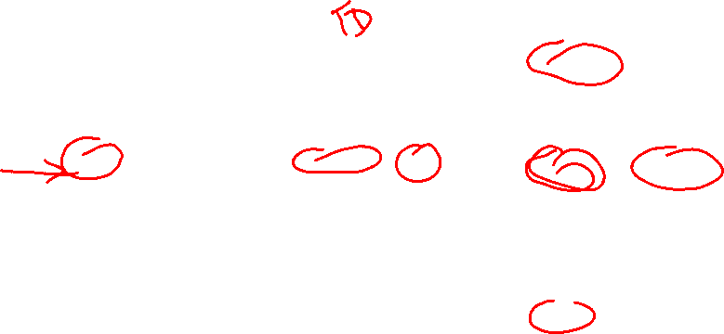
Third Normal Form

Slide 42

Third Normal Form
To make this table complies with 3NF we have to break the table into two tables to remove the transitive dependency of emp_zip:
employee table:
emp_id | emp_name | emp_zip
1001 | John | 282005
1002 | Ajeet | 222008
1006 | Lora | 282007
1101 | Lilly | 292008
1201 | Steve | 222999
employee_zip table:
emp_zip | emp_state | emp_city | emp_district
282005 | UP | Agra | Dayal Bagh
222008 | TN | Chennai | M-City
282007 | TN | Chennai | Urrapakkam
292008 | UK | Pauri | Bhagwan
222999 | MP | Gwalior | Ratan

Slide 43
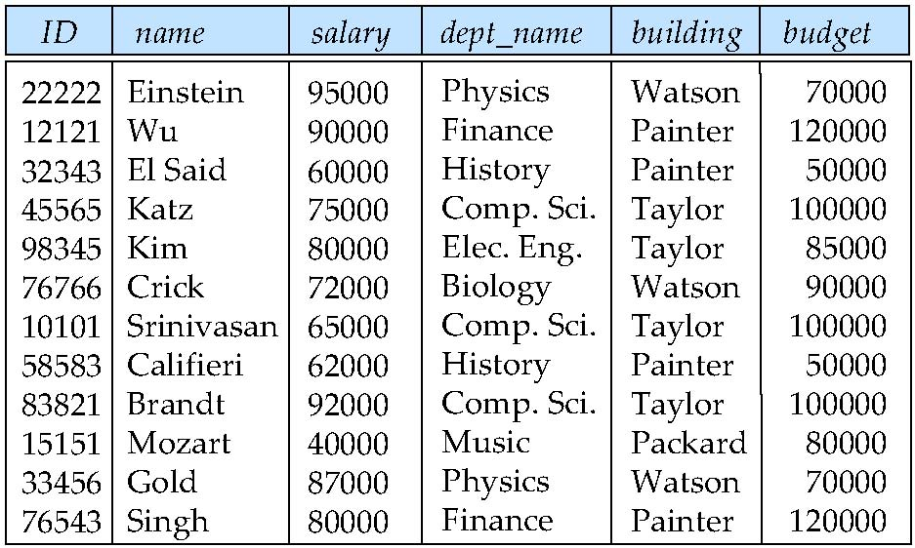
Example: Combined instructor-department table
What is the PK?
What are the functional dependencies? transitive dependency?
What are the insert, update, delete anomalies in the following table!!!!
dept_name ➔ building,budget

Slide 44

Normalization Process
The higher the normal form:
The less the redundancy
The less the anomalies
However, the higher the normal form:
More table decomposition
More join operations required to produce a specified output
More resources required from DBMS to answer user queries

Slide 45
Normalization and Database Design
ER diagram
Identifies relevant entities, their attributes, and their relationships
Identifies additional entities and attributes
Normalization procedures
Focus on characteristics of specific entities
Normalization process is attached to ERD modeling process

Slide 46
Normalization and Database Design
Make sure that proposed entities meet required normal form before table structures are created
Many real-world databases have been improperly designed or burdened with anomalies
You may be asked to redesign and modify existing databases

Slide 47
Denormalization
Creation of normalized relations is important database design goal
Performance or query execution time should also be a goal
If tables are decomposed to conform to normalization requirements:
Number of database tables expands
More time is needed to join tables

Slide 48
Denormalization (continued)
Joining the larger number of tables reduces system performance
Conflicts often resolved through compromises that may include denormalization:
Accept a level of redundancy in order to get better performance.
Problems with denormalization:
Data updates takes more time and resources

Slide 49
Denormalization for Performance
Example:
Displaying prereqs along with course_id, and title requires join of course with prereq
Alternative 1: Use denormalized relation containing attributes of course as well as prereq with all above attributes
faster lookup
extra space and extra execution time for updates
extra coding work for programmer and possibility of error in extra code
Alternative 2: use a materialized view defined as course prereq
Benefits and drawbacks same as above, except no extra coding work for programmer and avoids possible errors

Slide 50
Review Normalization Video
https://www.youtube.com/watch?v=QqlPXKxN6LQ
(25 minutes)

Slide 51
Overall Database Design Process
We have assumed schema R is given
R could have been generated when converting E-R diagram to a set of tables.
R could have been a single relation containing all attributes that are of interest (called universal relation).
Normalization breaks R into smaller relations.
R could have been the result of some ad hoc design of relations, which we then test/convert to normal form.

Slide 52
ER Model and Normalization
When an E-R diagram is carefully designed, identifying all entities correctly, the tables generated from the E-R diagram should not need further normalization.
However, in a real (imperfect) design, there can be functional dependencies from non-key attributes of an entity to other attributes of the entity
Example: an employee entity with attributes department_name and building, and a functional dependency department_name→ building
Good design would have made department an entity

Slide 53
Steps going from conceptual to logical design
Conceptual ERD:
the version that captures what the user said.
Includes:
entities (to become tables)
relationships (to become foreign keys)
is not implementable as a relational database.
Once the conceptual ER diagram is finished, and approved by the user, the conceptual ER need to be mapped to a Logical ERD
Logical ERD:
the version that is ready to hand to the data base administrator (DBA) to be turned into real tables.
can be mapped one-to-one to tables and foreign keys in a relational database.

Slide 54
Steps
1) Add all relevant attributes to each entity
2) replace each M-to-M relationships with an entity. Then, label all relationships: 1-1; 1-M; M-1; M-M. Look one more time at any 1-1 relationships: the two entities probably should be combined, unless there is a very good reason not to.
3) Put all tables into 1st Normal form:
Break compound attributes into separate attributes (address becomes street, city, state, zip) (name become firstName, middleInitial, lastName)
Get rid of repeating fields (multiple phone numbers). (Create another table for phone numbers)

Slide 55
Steps (continued)
4) put all tables into 2nd normal form. (Every non-key attribute depends on the whole key)
5) put all tables into 3rd normal form. (Every non-key attribute depends on nothing but the key)
6) Test the structure against representative multi-table SQL queries

Slide 56
Exercise 1
Instructor name | Course code
George | CS101, CS154
Atkins | CS152, PHY01, Chem33
Convert this table to 1NF

Slide 57
Exercise 2
Convert the table to 2NF and 3NF.

Slide 58
Exercise 3
An agency called InstantCover supplies part-time/temporary staff to hotels throughout Scotland. Following table shows time spent by agency staff working at Two hotels. National Insurance Number (NIN) uniquely identifies each employee.
Convert the table to 2NF and 3NF.

Slide 59
Reading and Assignment

